Slide 1
HTML Form Processing with PHP
Tips, Tricks, and Bad Ideas

Slide 2
Who is this guy?
Joe Ferguson - joe@joeferguson.me
Professionally
Web Developer at RocketFuel
PHP / LAMP Focused
Semi Professional
Co-Organizer for MemphisPHP.org
MidsouthMakers - Hackerspace Leader
HACKmemphis.com Organizer

Slide 3
Types of Forms
Login Form
Contact Form
Questionnaire
Sign Up Form
Order Form
Every application that interacts with the user uses forms in some manner.

Slide 4
The Problem (Use Case)
I have a PHP Application that needs input:
How do I…
safely
securely
reliably
... get that input or other data from my users?

Slide 5

Little Bobby Tables...
http://xkcd.com/327/

Slide 6
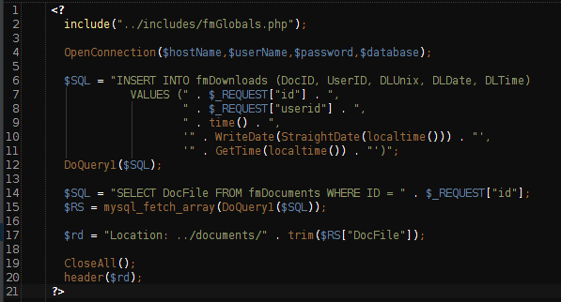
Bad Ideas:
Code stolen from someone I follow on twitter that was pointing out bad code…

Slide 7
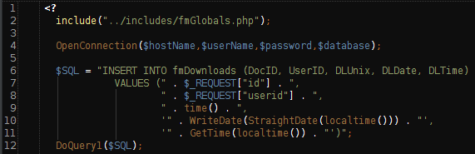
Whiskey...
What is this code even doing?!
open a database connection...
insert some data...
run the insert query….

Slide 8
Tango...
What is this code even doing?!
create a new query…
run the new query and return data...

Slide 9

Foxtrot...
What is this code even doing?!
close all open connections…
get us the heck out of here...

Slide 10
Why is the code bad?
Using PHP short tags
Must be enabled in php.ini use sparingly if at all
No data sanitization
Security?! never important
No data validation
who cares! he trusts his users
Directly saving user input into a database
Begging for a little bobby tables incident
Not using prepared statements
PDO - it’s the wave of the future!

Slide 11
How do I safely get form data?
Sanitize it!

Slide 12
How do I securely get form data?
HTTPS
(SSL)

Slide 13
How do I reliably get form data?
Validate it!

Slide 14
Assumptions for our examples
Existing JavaScript validation that input exists.
You are using a POST or GET method
You’re using SSL
You can find these slides and examples:
https://github.com/Svpernova09

Slide 15
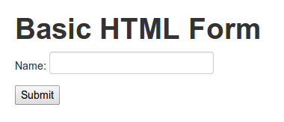
Oh PHP, you so easy….
Create our form:

Slide 16
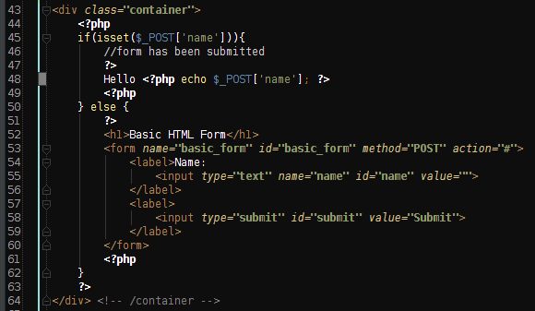
Oh PHP, you so easy….
Add our form processing:

Slide 17
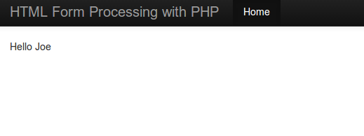
I’m REALLY good at this PHP thing
Output when the form has been submitted:

Slide 18
What if ....
...someone clever comes along?
...someone malicious comes along?

Slide 19
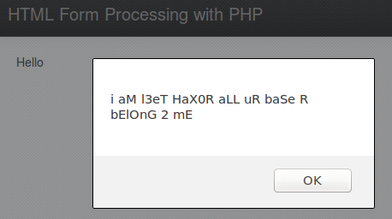
Wait a minute….
HOW DID THIS HAPPEN!!!111>>!??

Slide 20

It was all going so beautifully...
Where did we go wrong?
Line 53: We used the raw input from the user.
This leaves us WIDE open to many attacks.

Slide 21
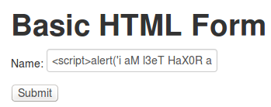
WTF! But PHP is so EASY!
The user put JavaScript in our field:
Since we just echoed the input, we injected the user’s JavaScript directly into our page:

Slide 22


How do we prevent such attacks?
We must go Back... to line 53!
htmlentities() = don’t parse as HTML
Browser:
Source:

Slide 23
Different ways to sanitize data
Data Filters
Validate Filters
FILTER_VALIDATE_EMAIL
FILTER_VALIDATE_INT
Sanitize Filters
FILTER_SANITIZE_STRING
FILTER_SANITIZE_NUMBER_INT
htmlspecialchars()
htmlentities()

Slide 24
htmlentities OR htmlspecialchars ?
htmlspecialchars() will encode only characters that have special significance in HTML
Example:
echo htmlspecialchars('<Il était une fois un être>.');
// Outputs: &lt;Il était une fois un être&gt;.
htmlentities() all characters which have HTML character entity equivalents are translated into these entities
Example:
echo htmlentities('<Il était une fois un être>.');
// Outputs: &lt;Il &eacute;tait une fois un &ecirc;tre&gt;
GREAT Explanation: http://stackoverflow.com/questions/46483/htmlentities-vs-htmlspecialchars

Slide 25
filter_var or html* ?
Data Filters are newer than html* functions
They are the “better” way.
They also depend on newer versions of PHP

Slide 26

But I’m a small shop, & trust users
You can’t trust input from ANYONE!
You
Your Parents
Your Co Workers
Your Boss
Your App’s Users
Other Apps
The Internet

Slide 27
Should I sanitize or validate?
BOTH!
SANITIZING your data is removing (or encoding) a specific set of characters from your data.
VALIDATING your data is making sure the data is in the format you expect to be in.

Slide 28
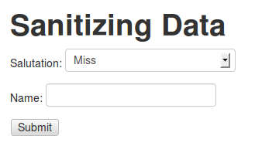
Sanitizing Data
Our new form (Example: 02 - Sanitizing Data)

Slide 29
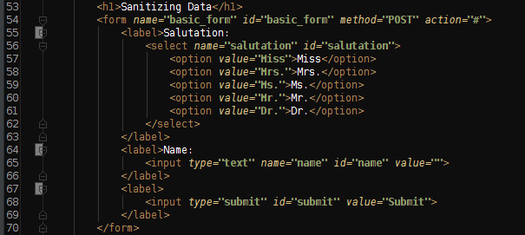
Sanitizing Data
Form Code View (Example: 02 - Sanitizing Data)

Slide 30
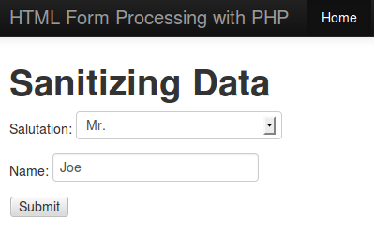
Sanitizing Data - Data Entry
This is the type of input we want...

Slide 31


Sanitizing Data - Data Entry
Make sure no malicious code is in the data...
Output:

Slide 32

Sanitizing Data - BETTER way
The more modern way: filter_var with flags:
Output is the same:

Slide 33
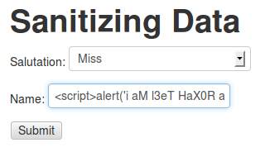

Testing our Data Sanitization

Slide 34
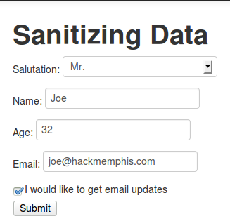
What about check boxes?
Let’s add a check box to our form

Slide 35
Sanitize everything!
Even check boxes should be sanitized

Slide 36
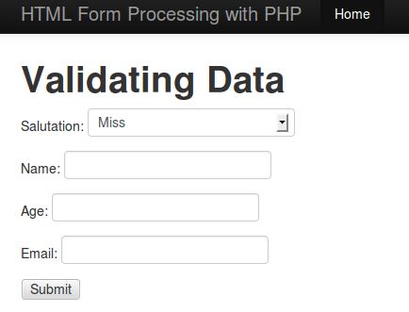
Validating User Input
Our new form (Example: 03 - Validating Data)

Slide 37
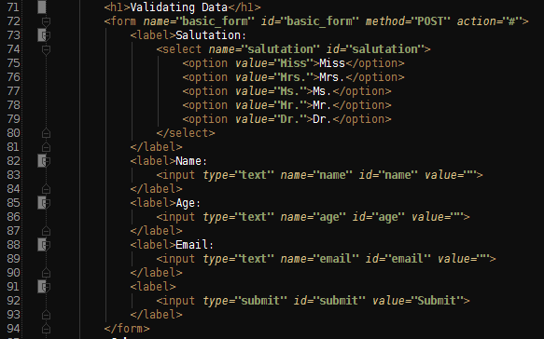
Validating User Input
Form Code View (Example: 03 - Validating Data)

Slide 38
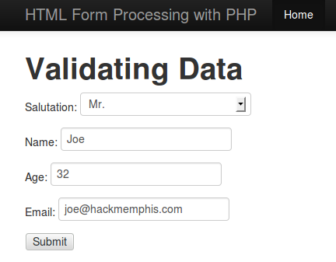
Validating User Input - Data Entry
This is the type of input we want...

Slide 39
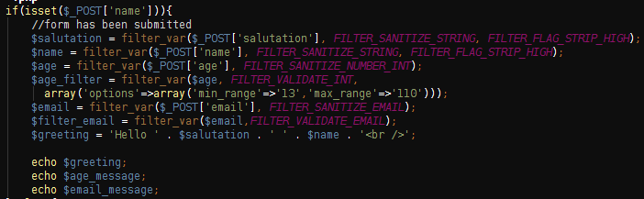
Validating Data - Data Entry
Make sure the data conforms to expectations

Slide 40
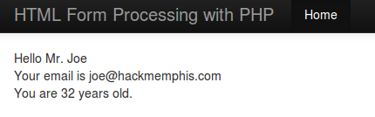
Validating Data - Data Entry
Output

Slide 41
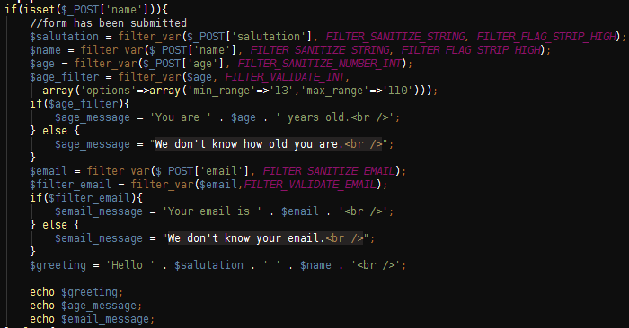
Testing Our Validation

Slide 42
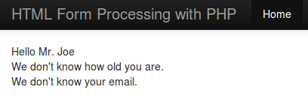
Testing Our Validation
If we don’t enter an age…
if we don’t enter our email...

Slide 43
What do we do with the data?
No matter what you do from here…
- the hard part is over.
Your data is now:
Validated!
Sanitized!

Slide 44
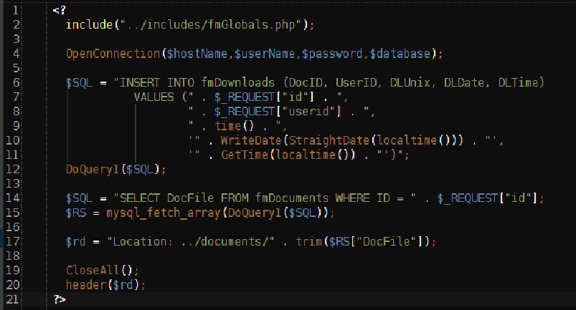
Remember that Bad Idea?

Slide 45
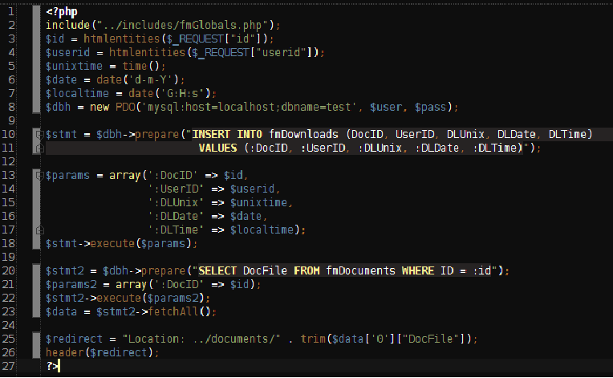
Better idea...

Slide 46
Tips
ALWAYS Sanitize your data.
Even if you don’t validate it.
Some data is harder to validate than others
Use JavaScript to enforce requirements
JavaScript is great for checking data before it gets submitted. This makes PHP’s job easier
Don’t rely on JS to sanitize. Let PHP handle it.
Offload your PHP processing via Ajax
Keeps your code cleaner by separating heavy lifting of data validation out of your form code.
Show your users where they failed.
This also makes your own debugging easier

Slide 47
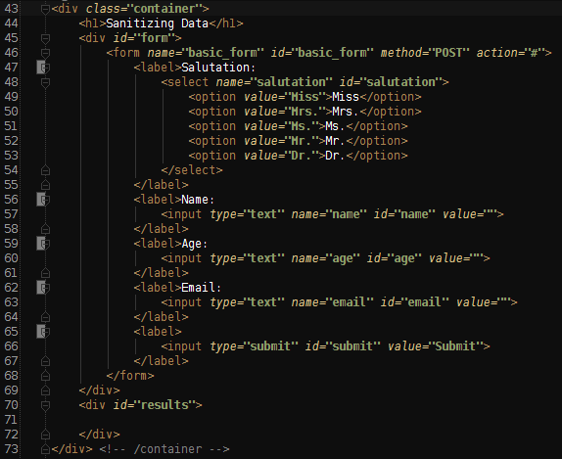
Tricks - Ajax Form Handling
Form Code View (Example: 04 Ajax Form Handling)

Slide 48
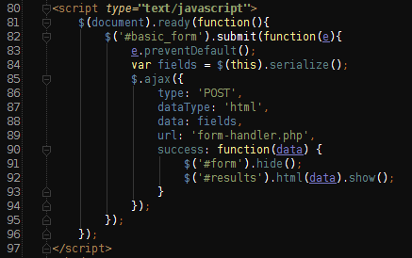
Tricks Ajax Form Handling
Ajax JavaScript to post the form

Slide 49
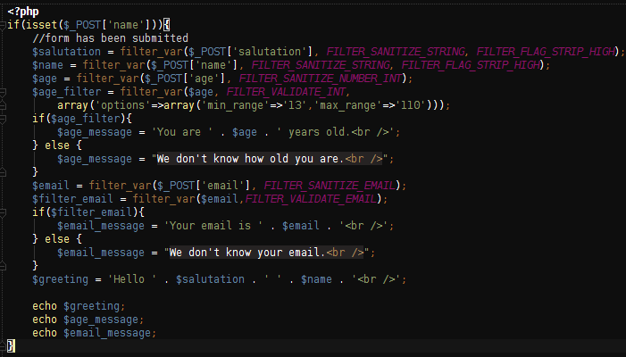
Tricks Ajax Form Handling
This is the file we’re posting the form data to

Slide 50
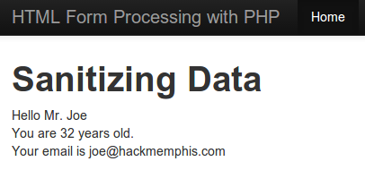
Tricks Ajax Form Handling Output
This allows you to separate logic away from the file that contains your form.

Slide 51

Tricks - Some tricks won’t last...
Issue: Application Form getting spammed.
Steps taken:
We added reCAPTCHA
Issue slowed, after some time they continued
Further steps:
For some reason the spam stopped...

Slide 52
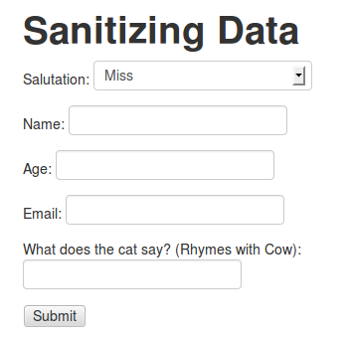
Tricks - Getting Creative
Add a question to your form:

Slide 53
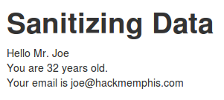
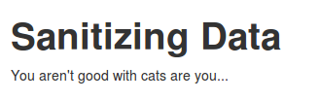
Tricks - Getting Creative
If the user answers correctly:
If the user answers incorrectly:

Slide 54
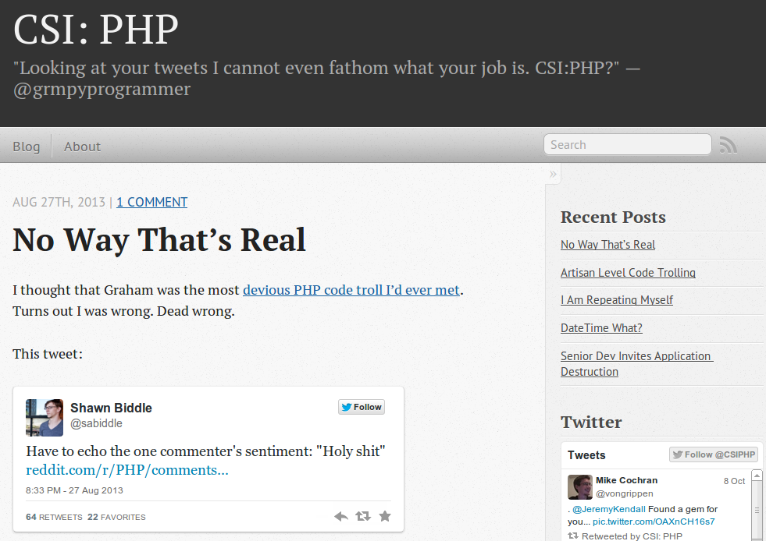
Better Ideas: CSI:php - csiphp.com
CSI:PHP is a great site to see not only bad code, but WHY it’s bad and how to make it better.

Slide 55
Links - Q & A
MemphisPHP.org
phptherightway.com
CSIPHP.com
Slides & Code Samples:
https://github.com/svpernova09
htmlentities() or htmlspecialchars()?
http://stackoverflow.com/questions/46483/htmlentities-vs-htmlspecialchars
xkcd: http://xkcd.com/

